Slide 1
Bazel & Conan

Slide 2
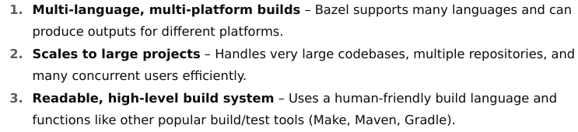
Intro to Bazel
Bazel is an open-source (Apache 2.0) build and test automation tool developed by Google.
It's designed to handle large, complex software projects with multiple languages and platforms, ensuring fast, reproducible, and correct builds.

Slide 3
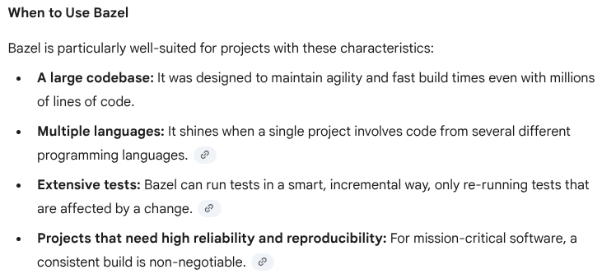

Slide 4
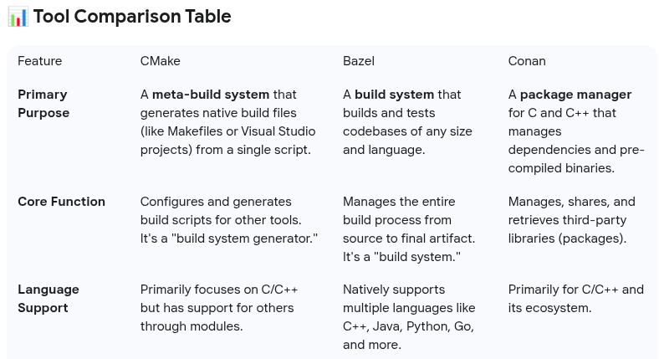

Slide 5
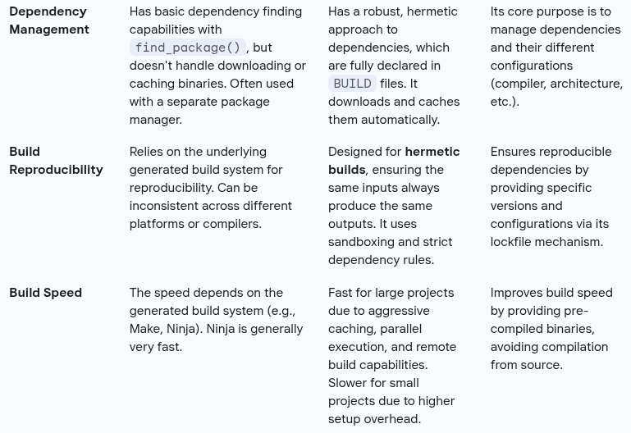

Slide 6
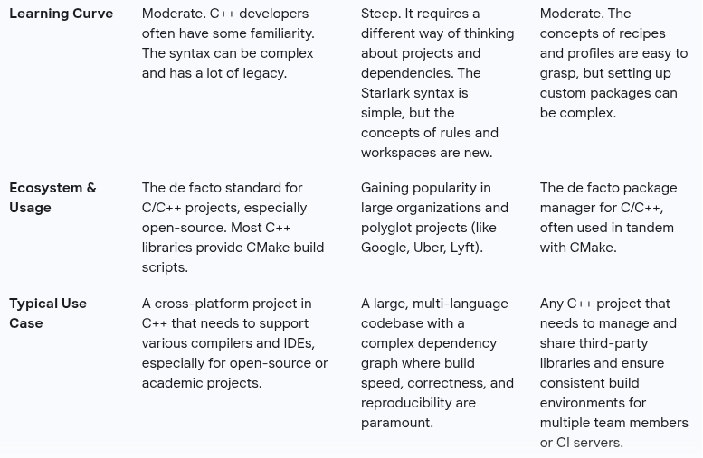

Slide 7
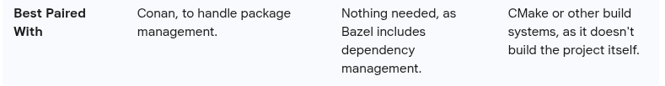

Slide 8
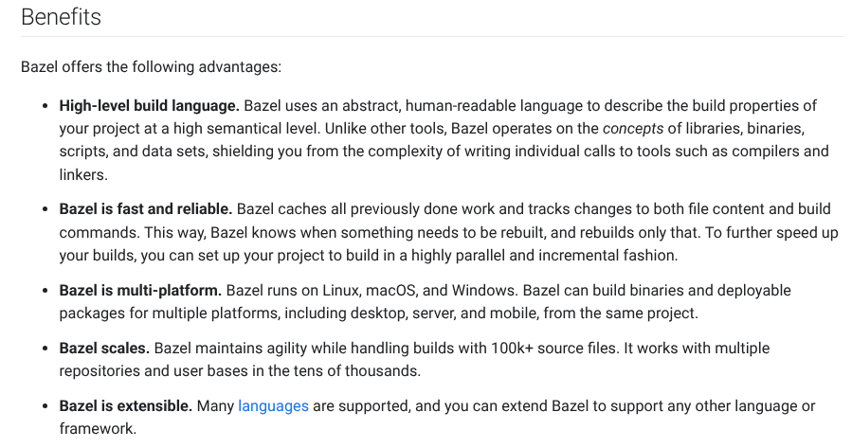

Slide 9
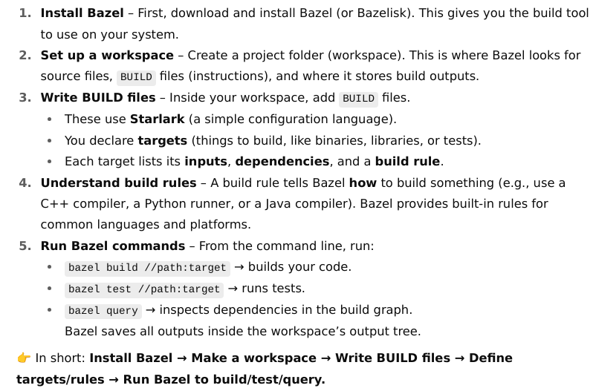
Using Bazel

Slide 10
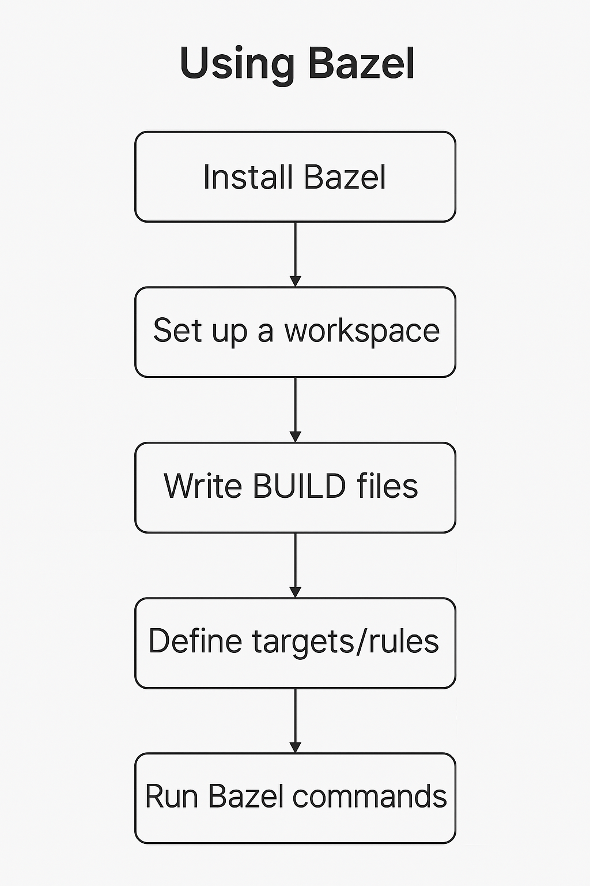

Slide 11
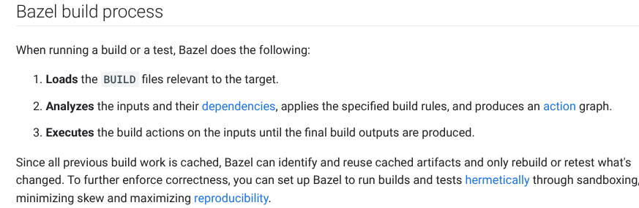
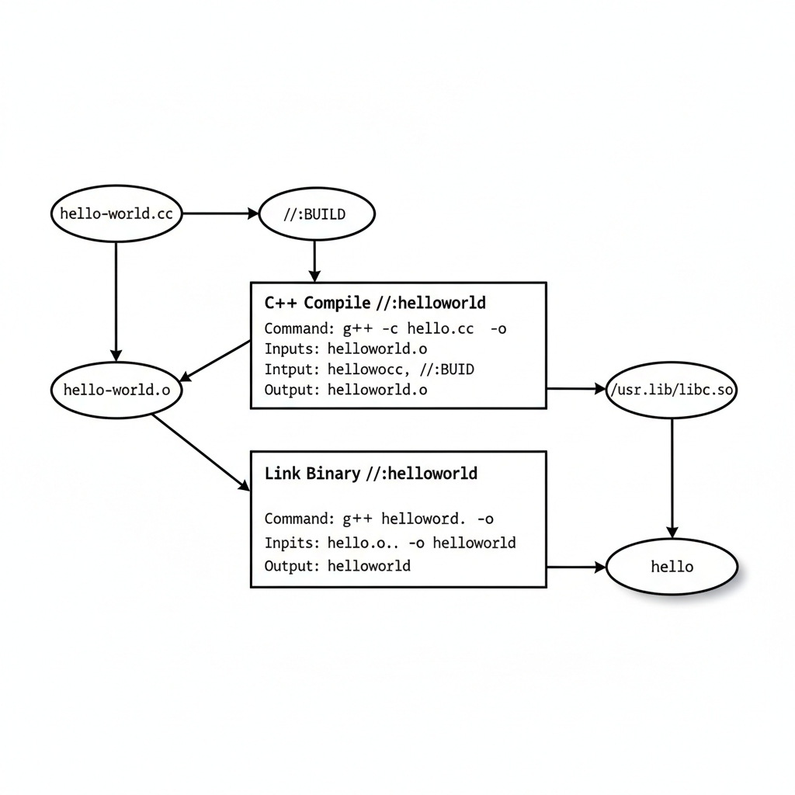

Slide 12
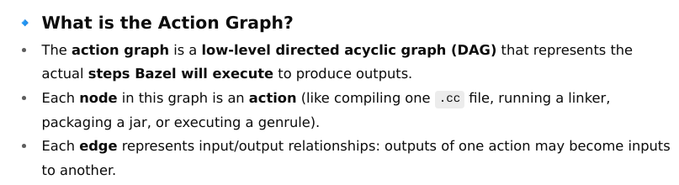
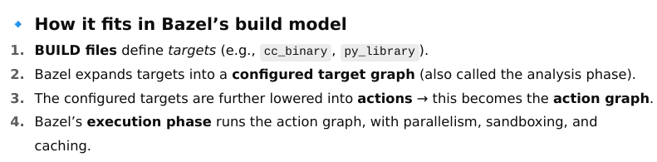
Action Graph
Action graph is one of the core internal concepts that explains how Bazel executes your build.

Slide 13
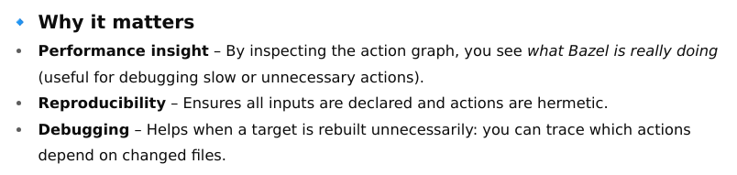
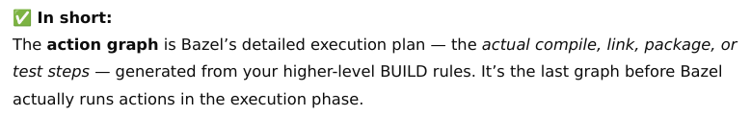

Slide 14
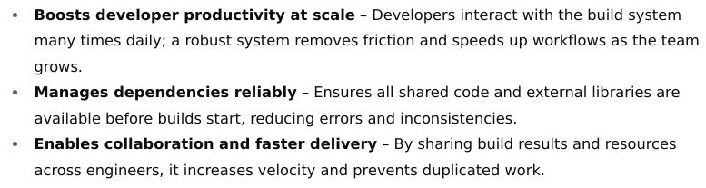
Build Basics

Slide 15
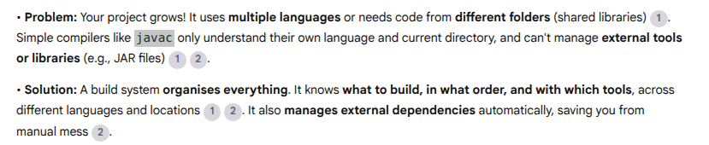
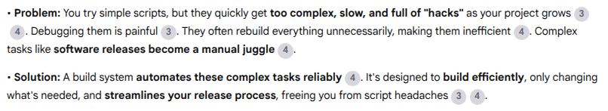
Why a Build System?
5 Key reasons
Compilers Alone Can't Handle Complexity
Shell Scripts Become a Maintenance Headache

Slide 16
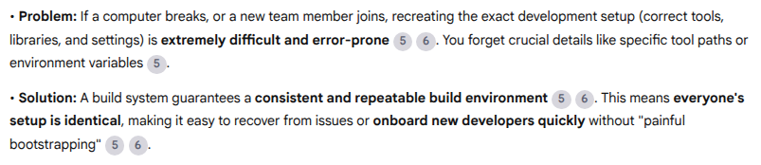
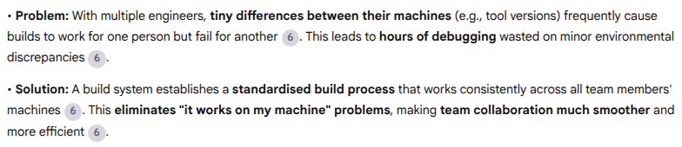
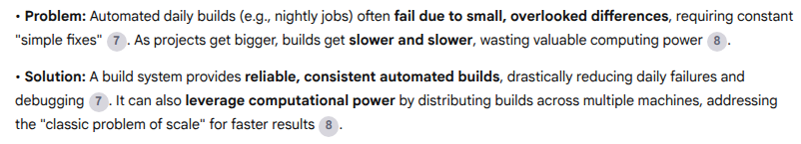
Ensure Consistent & Reproducible Environments
Smooth Team Collaboration
Reliable Automation & Scalable Performance

Slide 17
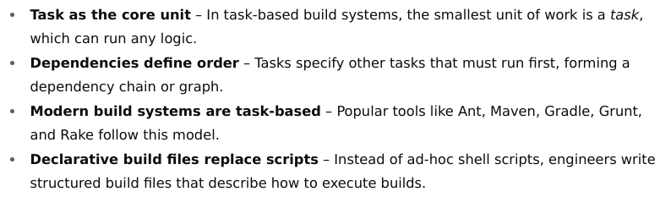
Task-Based Build Systems
Understanding task-based build systems

Slide 18
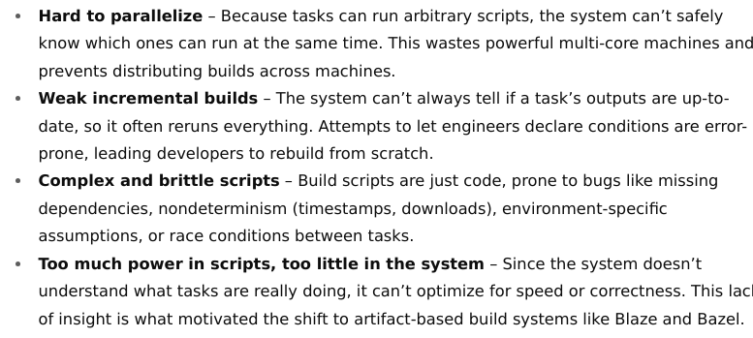
Dark side of task-based build systems

Slide 19
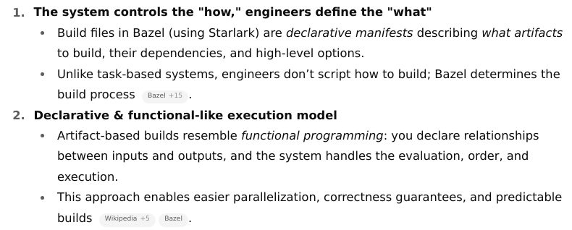
Artifact-Based Build Systems

Slide 20
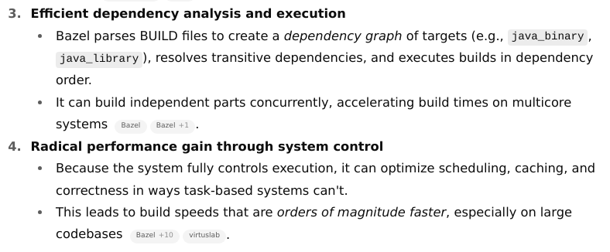
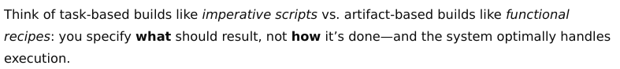

Slide 21
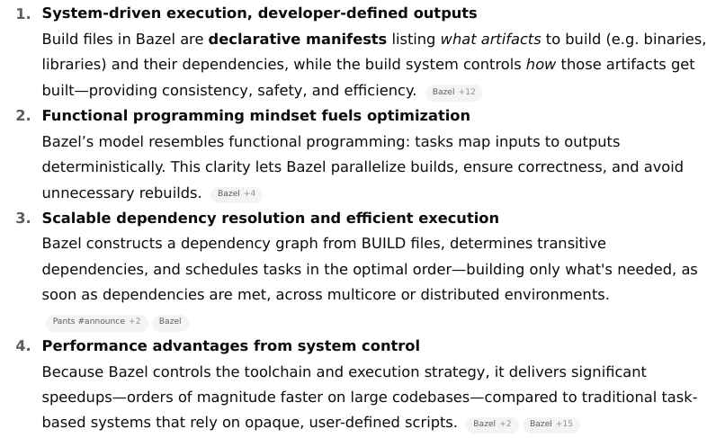
Artifact-Based Build Systems (e.g., Bazel)

Slide 22
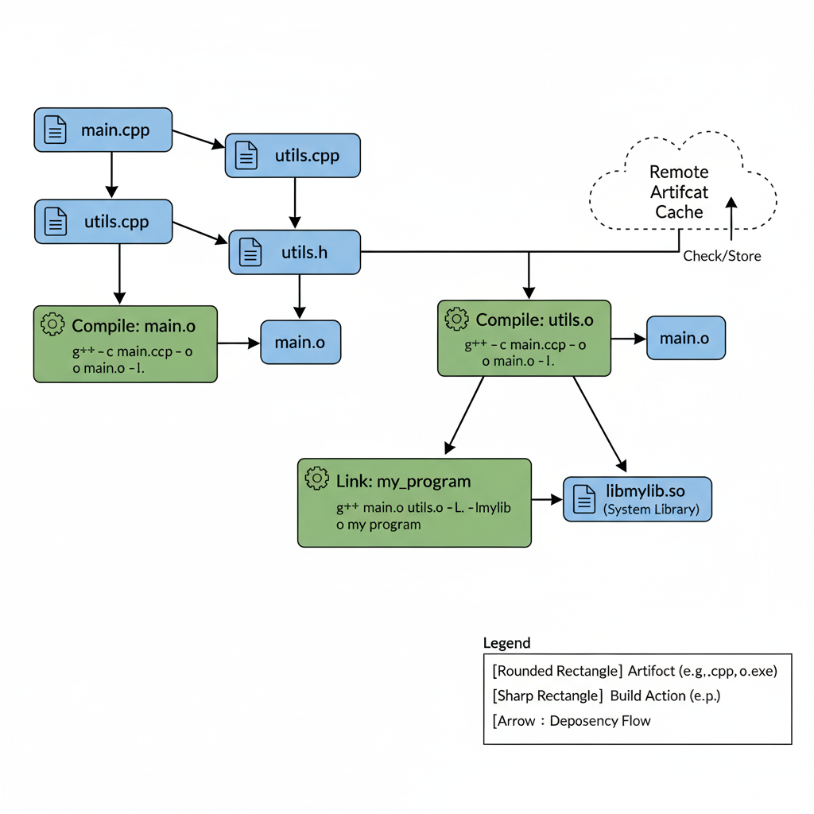
Artifact-Based Build Systems
An artifact-based build system fundamentally focuses on the outputs of build steps, rather than just the commands that produce them.
The core idea is that each build step takes a set of input artifacts and produces a set of output artifacts.
If the inputs haven't changed, the output artifacts are considered "up-to-date," and the step doesn't need to be re-executed.
This is key to efficient incremental builds.

Slide 23
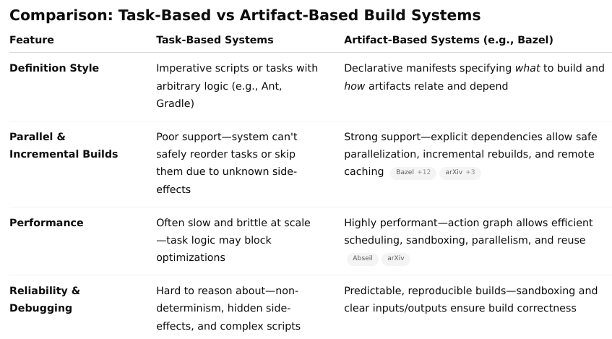
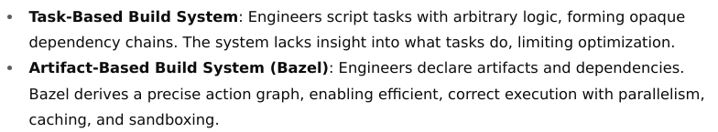

Slide 24
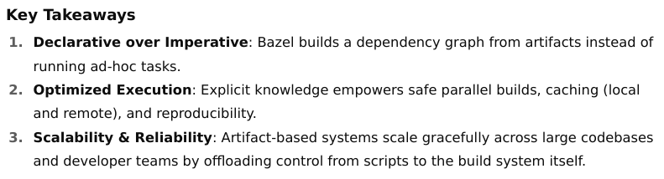

Slide 25
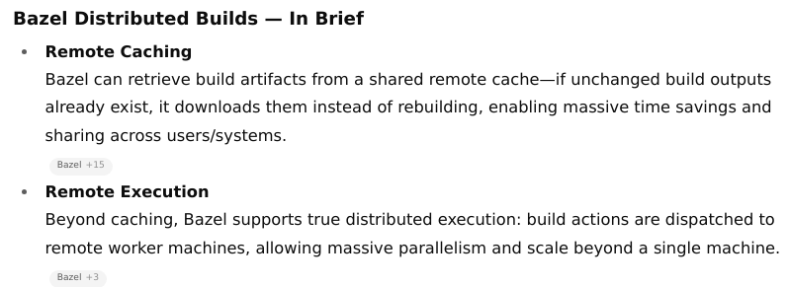
Distributed Builds

Slide 26
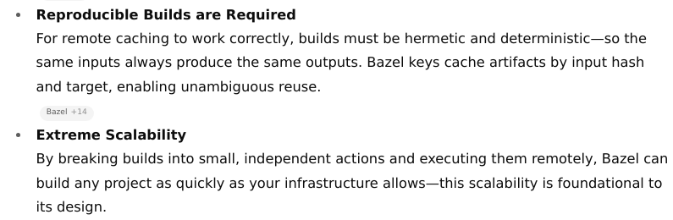

Slide 27
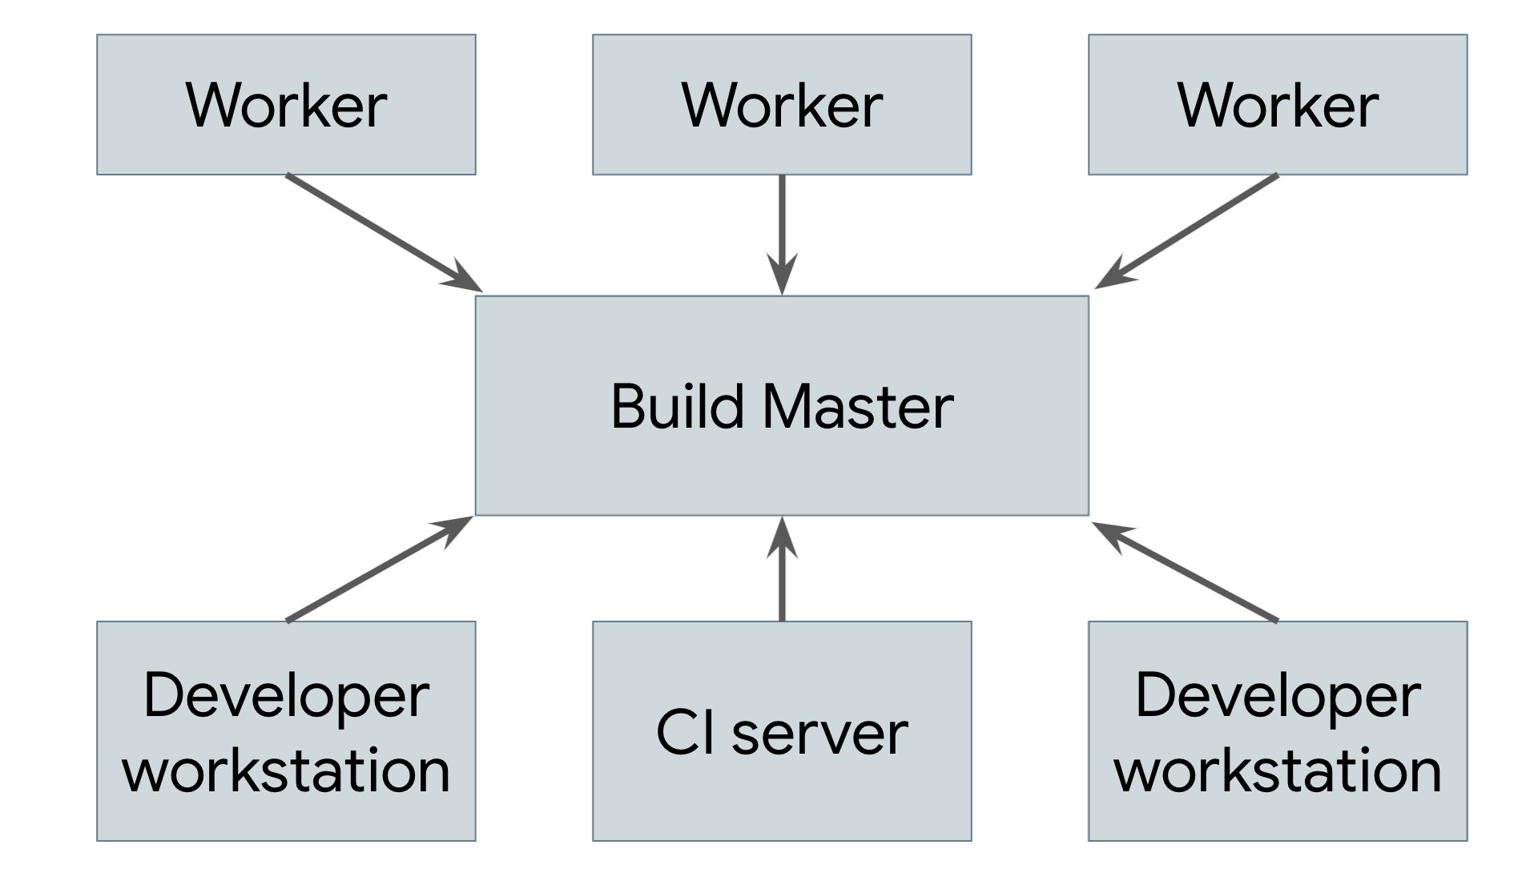
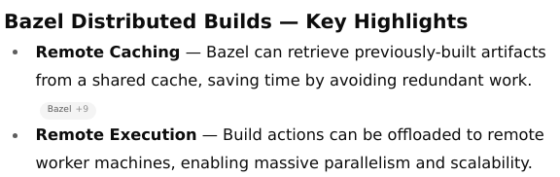
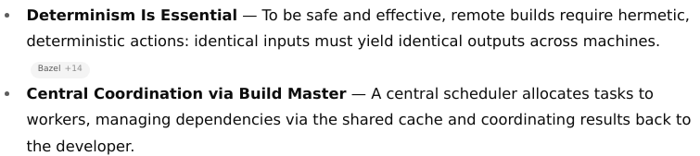

Slide 28
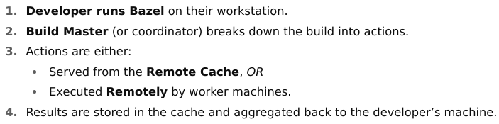
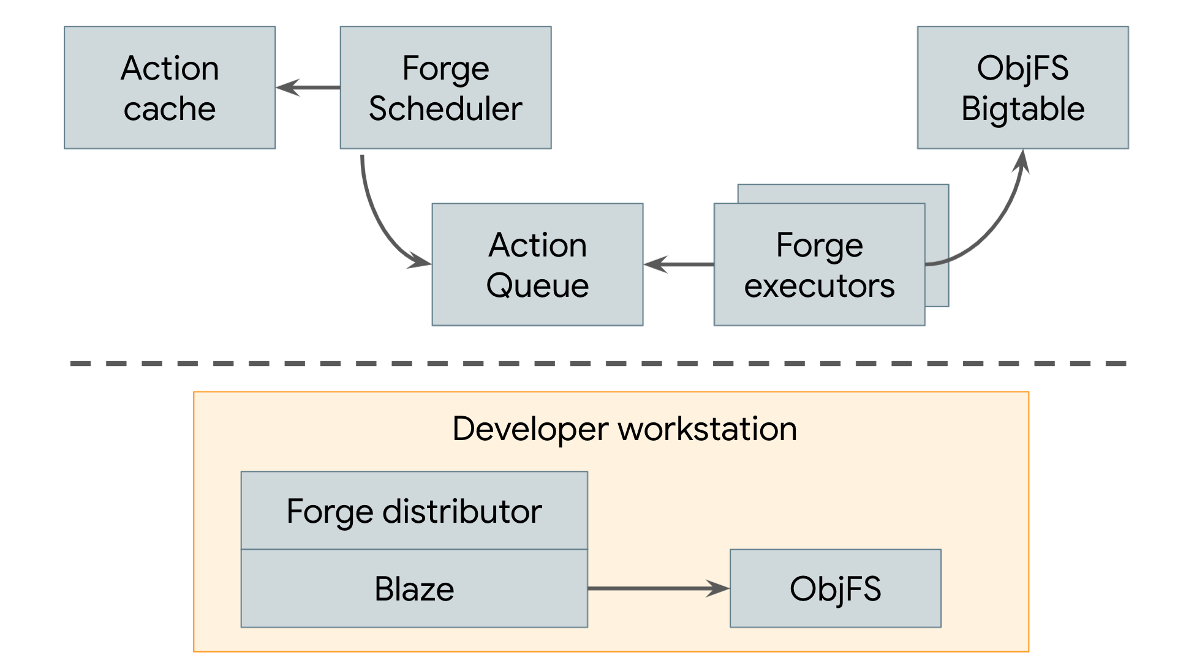
Distributed builds at Google

Slide 29
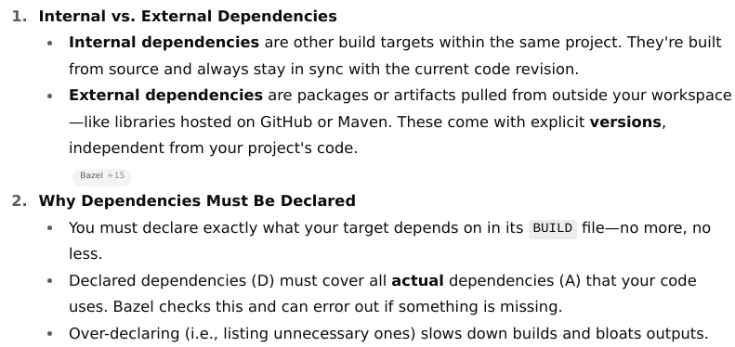
Dependency Management

Slide 30
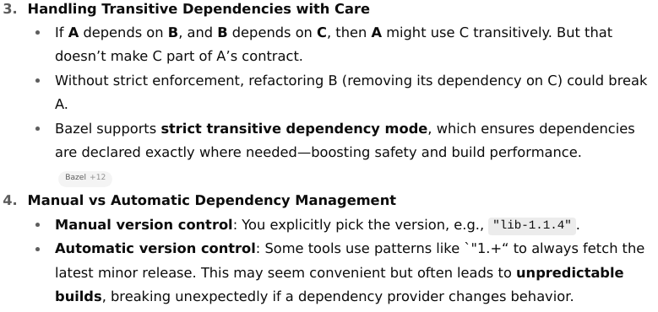

Slide 31
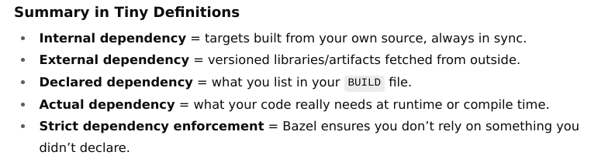

Slide 32
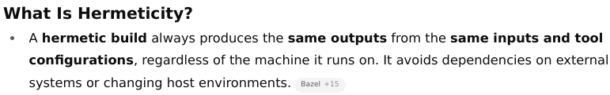
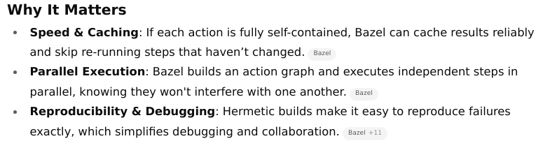
Hermeticity

Slide 33
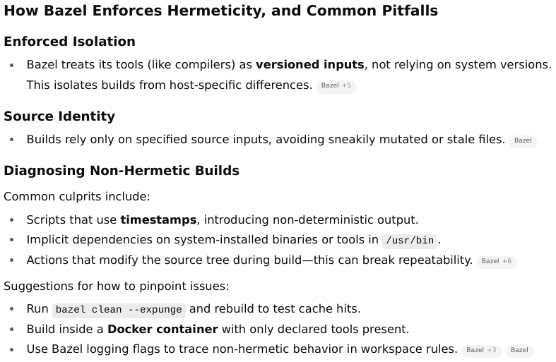

Slide 34
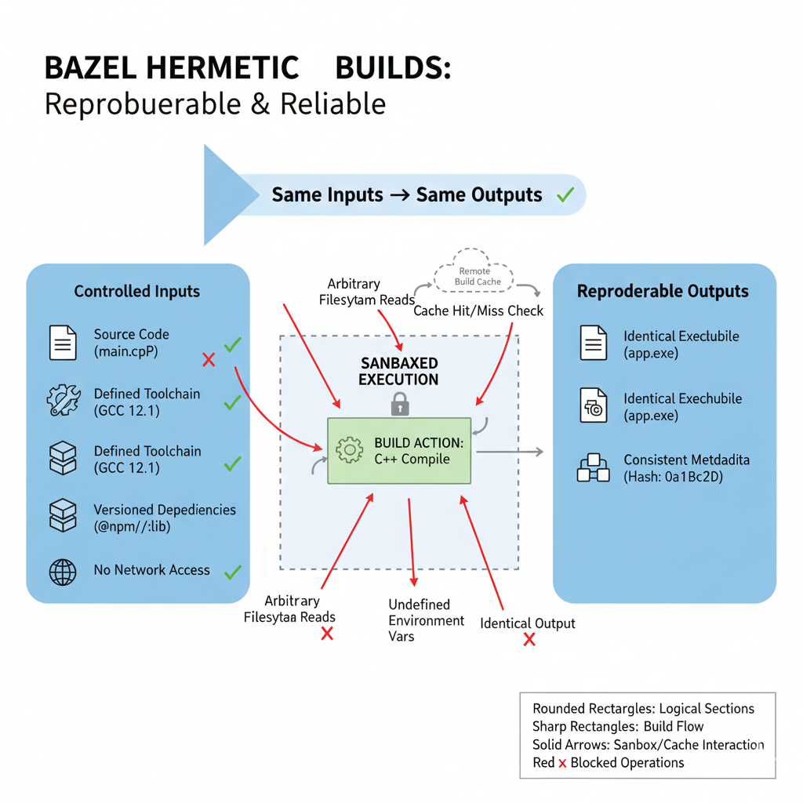

Slide 35
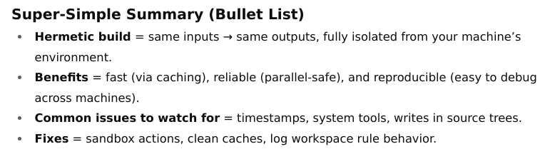
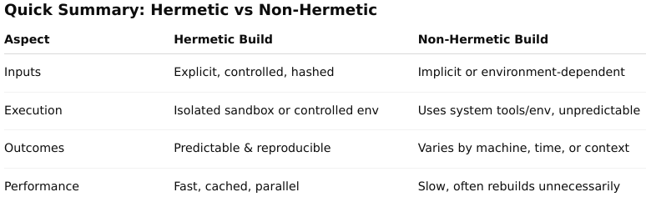

Slide 36

Concepts

Slide 37
Repositories,
workspaces,
packages, and
targets

Slide 38
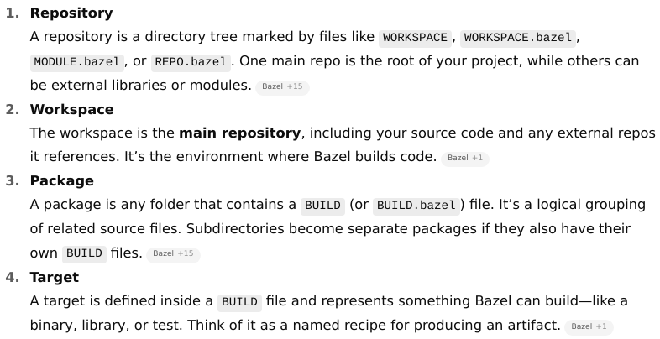

Slide 39
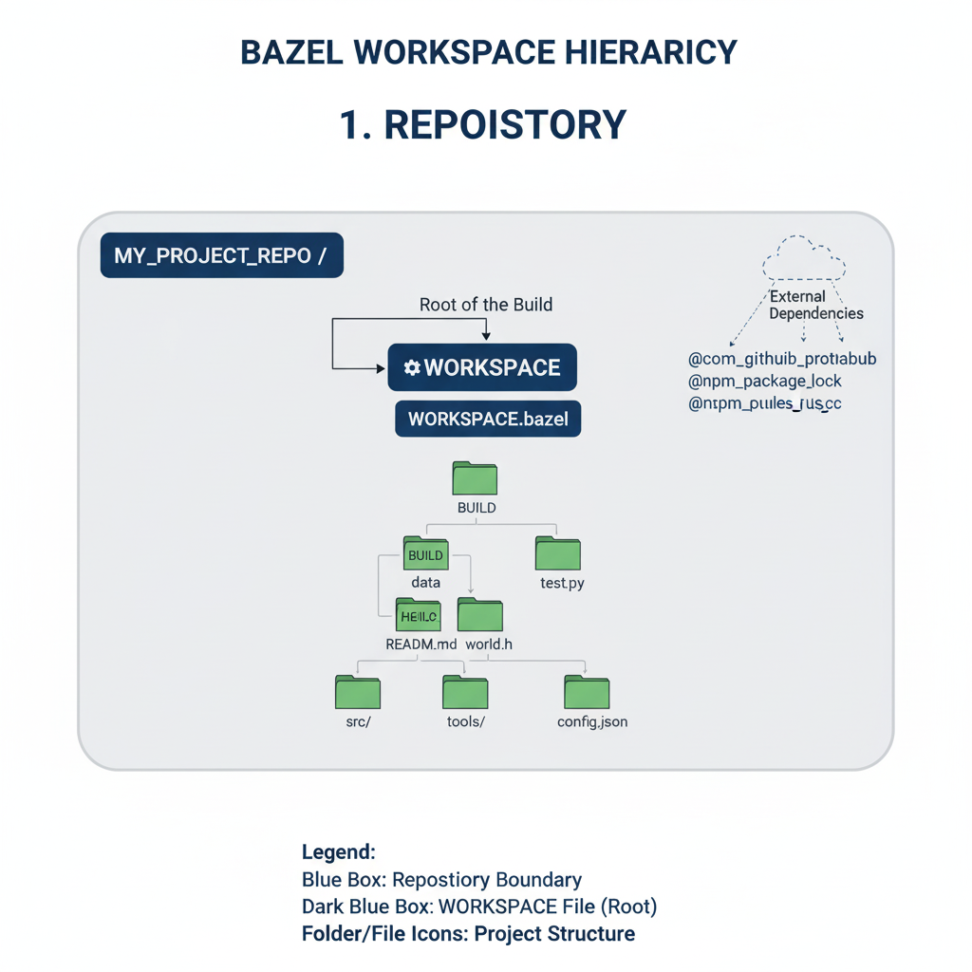
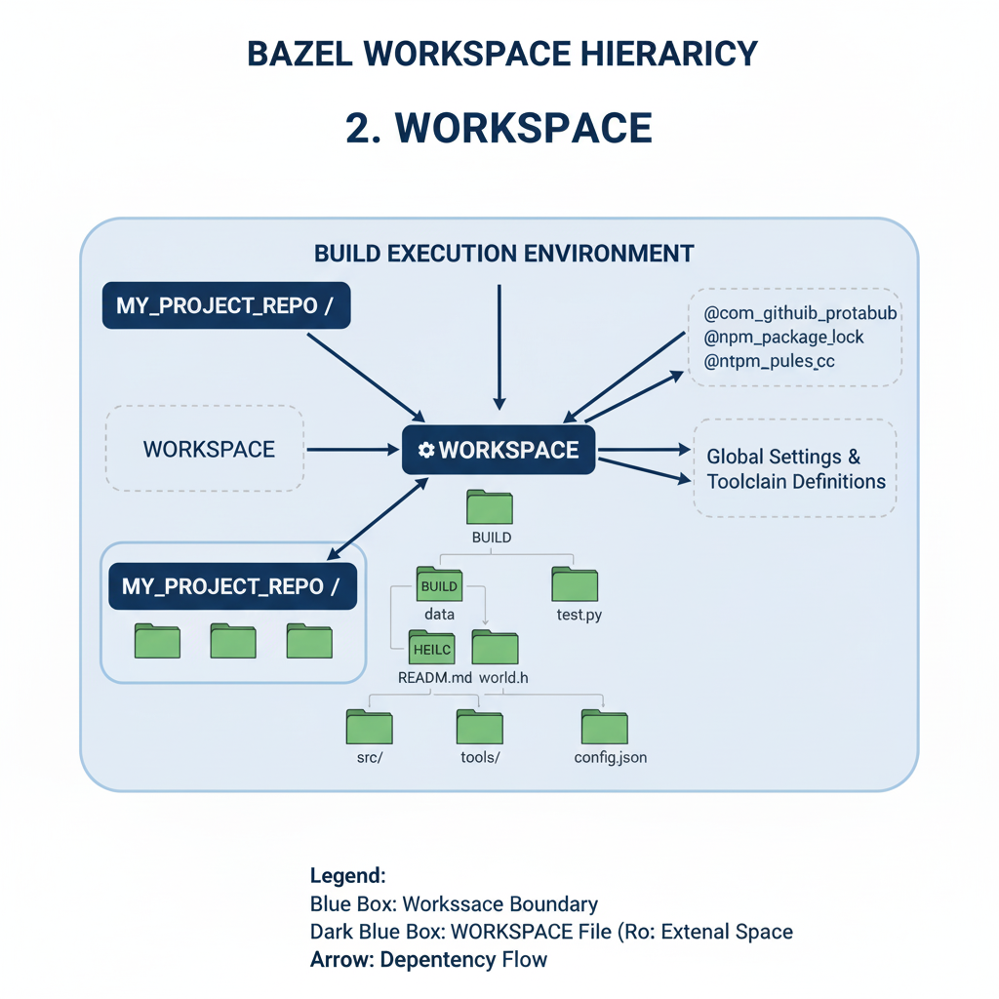
Workspace is the environment where Bazel executes builds.
Repository is the top-level container for source code and build definitions.

Slide 40


Target is the smallest unit that Bazel can build. It's an instance of a rule
Package is a directory within a Bazel workspace that contains a BUILD file (or BUILD.bazel)

Slide 41



Slide 42




Bazel’s Structural Hierarchy

Slide 43


Labels

Slide 44





Slide 45


BUILD files

Slide 46


Slide 47


the cc_binary rule creates a binary target that depends on the hello_cc library.

Slide 48



Loading an extension

Slide 49




Slide 50


Slide 51


Slide 52



Slide 53


Slide 54
Types of build rules

Slide 55


Slide 56



Slide 57



Slide 58



Slide 59


Slide 60
How to create rules
We willl learn:
how to write simple Starlark rules,
how to use them in BUILD files, and
how to bazel build / bazel run them with a complete, working example.

Slide 61

Write your first custom rules (Starlark)
Create tools/my_rules.bzl and add three rules to learn the basics:
hello_file: writes a new file from a string attribute (+ a template).
concat_files: concatenates multiple input files using actions.run_shell.
py_transform: runs a Python tool to transform an input file to an output (shows runfiles + tools).
Concepts you just used:
rule() with attrs → define inputs (strings, labels, lists)
ctx.actions.write() → create a file from literal content
ctx.actions.run_shell() → invoke inline shell to process files
ctx.actions.run() with executable/tools → run a tool (Python script here)
Return DefaultInfo with produced outputs so Bazel knows what to build
Review my_rules.bzl

Slide 62
# See what targets exist:
bazel query //...
# 1) Build the 'hello_file' rule output
bazel build //examples:hello_out
# Inspect the generated file:
cat bazel-bin/examples/hello_out.txt
# 2) Build the concatenation output
bazel build //examples:joined
cat bazel-bin/examples/joined.txt
# 3) Build the Python-transform output
bazel build //examples:upper_a
cat bazel-bin/examples/upper_a.txt
# 4) Run the demo binary to print all three artifacts:
bazel run //examples/app:main -- show
# 5) Run the test
bazel test //examples:joined_has_alpha_test

Slide 63

bazel queries, aquery, cquery
Refer:-
vscode - bazel_query
bazel_queries_readme

Slide 64


Visualize Dependencies of //app:main

Slide 65


Reverse Dependencies - Who Depends on //lib:math?
Complete Workspace Overview

Slide 66

Advanced Graph Customization

Slide 67


Compare Two Targets

Slide 68
Why “configured queries” exist
Bazel actually operates in two worlds:
Target graph — what you write in your BUILD files (logical structure).
Configured target graph — what Bazel builds after applying all configurations (platforms, flags, toolchains, etc.).
Most of the time, bazel query works on the target graph — the abstract dependencies before Bazel applies any configuration logic.
But when you run a build, Bazel works on the configured targets — for eg:
The same library might be built twice: once for x86, once for ARM.
A select() may choose different deps under different build flags.
Toolchain transitions might result in separate configurations.
That’s where configured queries come in. - post configuration

Slide 69
Dependencies

Slide 70


Dependency Declaration Pitfalls

Slide 71


Slide 72


Slide 73
Types of Dependencies in Bazel

Slide 74



Slide 75



Slide 76



Slide 77


Slide 78

Using Labels to Reference Directories in data

Slide 79



Slide 80



Slide 81



Slide 82


Slide 83
Visibility

Slide 84


Target visibility

Slide 85


If client is not included, this load would fail.
Add "public" for wide access, or "private" for same-package-only.

Slide 86

Refer mm - visibility.png

Slide 87


Platforms & Toolchains
Result: You can tell Bazel “build this target for ARM64 Linux” by selecting that platform.

Slide 88



Slide 89



Slide 90



Slide 91


Slide 92
Bazel : Build a C++ Project

Slide 93





Stage 1 single target, single package
bazel build //main:hello-world
bazel-bin/main/hello-world

Slide 94

bazel build //...

Slide 95





Stage2 : multiple build targets
bazel build //main:hello-world
bazel-bin/main/hello-world

Slide 96


Slide 97









Stage3 multiple packages

Slide 98

bazel build //main:hello-world
bazel-bin/main/hello-world

Slide 99






Stage 4

Slide 100
C++ Build Use Cases

Slide 101

How do we -
Including multiple files in a target

Slide 102

Using transitive includes

Slide 103




Slide 104

Adding include paths

Slide 105



Use Case: Legacy Library

Slide 106





Include external libraries

Slide 107



Adding dependencies on precompiled libraries

Slide 108
Bazel : Configure C++ Toolchains

Slide 109




Slide 110


Slide 111



Slide 112

bazel build //main:hello-world --toolchain_resolution_debug=@bazel_tools//tools/cpp:toolchain_type

Slide 113


Review the dependency graph
sudo apt update && sudo apt install graphviz xdot

Slide 114
Remote Execution

Slide 115


Slide 116


Slide 117


Slide 118


Slide 119


Slide 120


Slide 121
Mini setup to try Remote Cache only

Slide 122


Slide 123





Slide 124




Slide 125



Slide 126


Slide 127
Configurable Build Attribute

Slide 128


Slide 129


Slide 130


Slide 131




Slide 132






Slide 133






Slide 134
Custom Rules
and
Macros

Slide 135


Slide 136
Use Case Example: A Python Code Generator 🐍

Slide 137




Slide 138





Slide 139




Slide 140






Slide 141


Slide 142


Stage 9_py-bazel-demo

Slide 143





Stage 9_py-bazel-demo

Slide 144




Slide 145


Slide 146
Query quickstart

Slide 147
Conan, software package manager

Slide 148


Slide 149
Decentralized package manager
Conan is a decentralized package manager with a client-server architecture.
This means that clients can fetch packages from, as well as upload packages to, different servers (“remotes”), similar to the “git” push-pull model to/from git remotes.
At a high level, the servers are just storing packages.
They do not build nor create the packages.
The packages are created by the client, and if binaries are built from sources, that compilation is also done by the client application.

Slide 150



Slide 151


Binary management

Slide 152


Slide 153



Slide 154


Slide 155



3.1 Create CMakeLists.txt

Slide 156


Slide 157



Slide 158


Slide 159


Slide 160


Slide 161


Slide 162


Slide 163


Slide 165


